Slide 1

Stock Closing Price Prediction Using AI
Hussein Issa

Slide 2

Project Overview
Predicting next-day closing prices with enhanced accuracy using machine learning.
While linear regression can establish baseline performance, LSTM models will outperform due to their ability to capture time-series dependencies.
A comparative approach will determine the effectiveness of linear regression against LSTM models implemented in TensorFlow and PyTorch.
With around 6 datasets like google, apple, Microsoft, cisco, nbk and amazon with a lot of training models done.

Slide 3
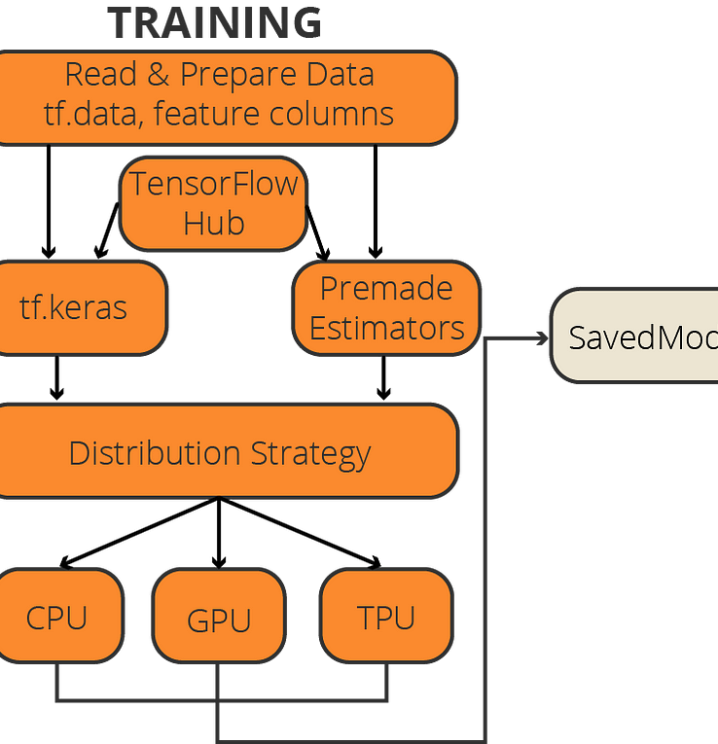
Technological Framework
Python was chosen for its extensive libraries like pandas and NumPy for data manipulation, and Matplotlib for visualization.
TensorFlow provided the infrastructure for deep learning models, especially LSTM, which is suitable for time-series data.
PyTorch was selected for its dynamic computational graph that allows for flexible model adjustments.
Development was facilitated by Google Colab; version control was managed with Git.

Slide 4
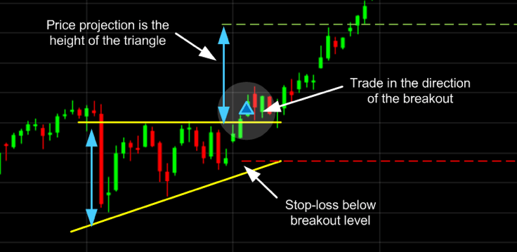
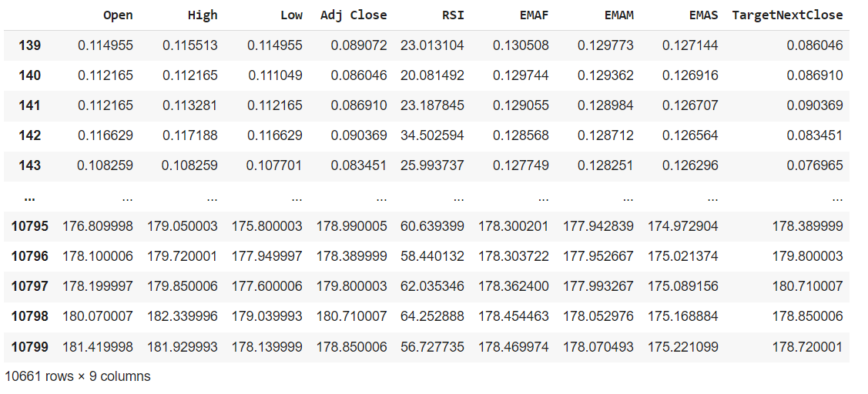
Data Collection & Preprocessing
Historical stock prices spanning over more then ten years were collected from multiple exchanges to ensure data diversity.
Preprocessing included cleaning, normalizing, and transforming the data to a format suitable for time-series analysis.
Feature engineering extracted meaningful attributes such as moving averages and price volatility indicators.

Slide 5
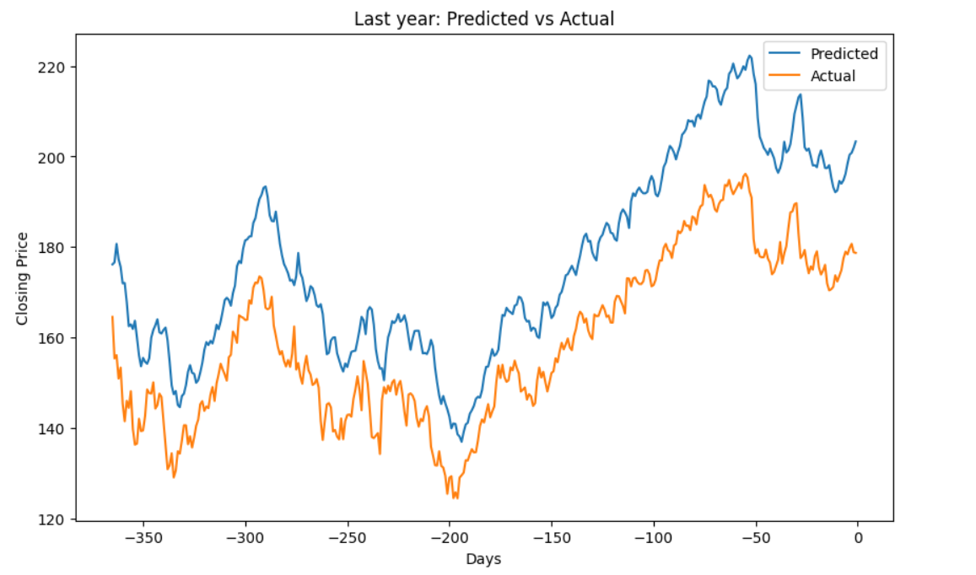
Model Development & Selection
Linear regression served as a benchmark due to its simplicity and quick computation.
LSTM models were developed with a focus on capturing the sequential nature of stock data, using TensorFlow for its established infrastructure and PyTorch for its experimental flexibility.
pyTorchh framework did a greate job with the closing prices loopback prediction

Slide 6
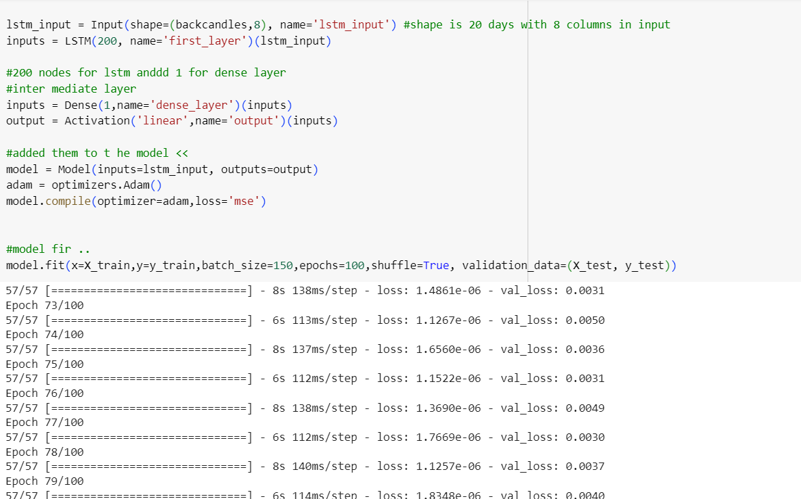
Training & Validation
The dataset was divided into training and testing sets I tried a lot of numbers for best acccuracy.
predicted the target by applying the test part to it then comparing them, then I concluded the r2 score and the errors to see if the model is fitted well.
Model performance was continuously monitored and compared against the validation set to prevent overfitting.

Slide 7
Challenges Encountered
Overfitting was a significant challenge, countered by implementing dropout and regularization techniques.
some values was having missing values and null rows and 0 rows, so I had to deal with that
minmax scaler was hard to inverse it after the prediction part so I can see the real values
the data set features was only 4 so I had to create more feature to make the model more dynamic.

Slide 8
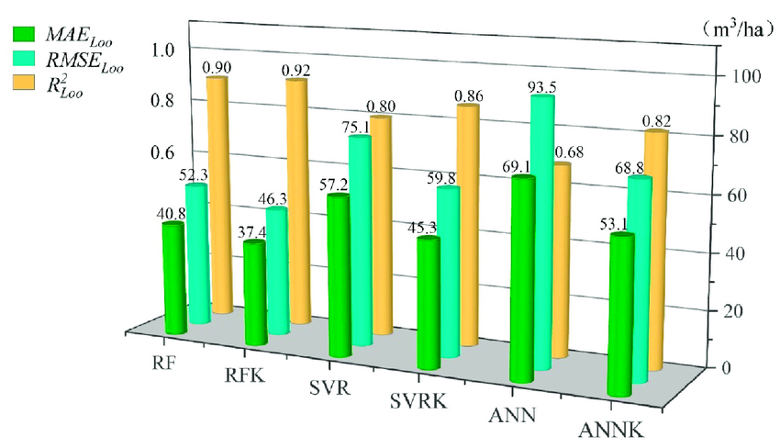
Results & Comparative Analysis
The linear regression model achieved an accuracy more than 90%, setting a baseline for model comparison.
TensorFlow LSTM improved accuracy to 96%, demonstrating the model's ability to capture more complex patterns.
PyTorch LSTM achieved the highest accuracy at 95%, reflecting its superior model architecture and training process.
Comparative analysis showed LSTM's superiority in modeling time-dependent data like stock prices.

Slide 9
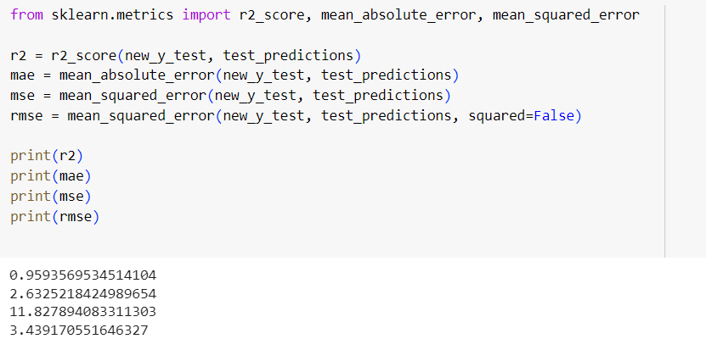

Slide 10
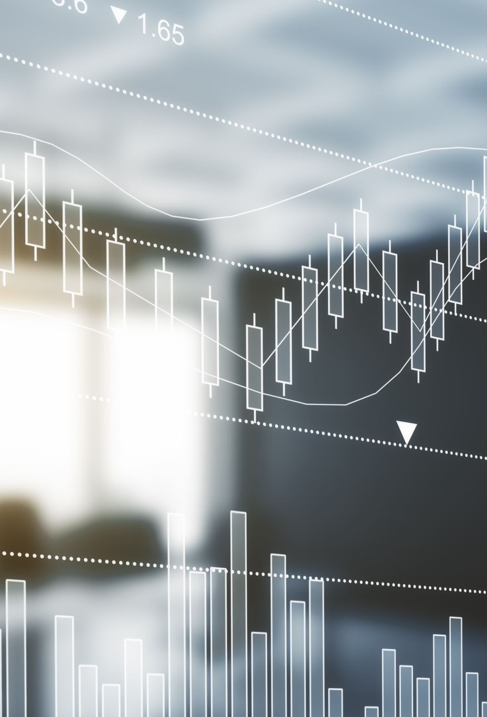
Future Directions
I would collect more specific databases that reach the yesterday date that can predict the real time now.
Plans to expand the models to global stock indices will allow for a comprehensive analysis of international markets.
Exploration of reinforcement learning techniques is expected to enhance the model's adaptability to market dynamics.

Slide 11

Conclusion
The study concluded that LSTM models, particularly those implemented in PyTorch, offer a significant advantage in predicting stock market trends over linear regression.
The findings underscore the potential of using advanced machine learning techniques in financial forecasting.
The project represents a step towards more accurate stock market analysis tools.

